Slide 1

Containerization 101
By Chetan Shah

Slide 2
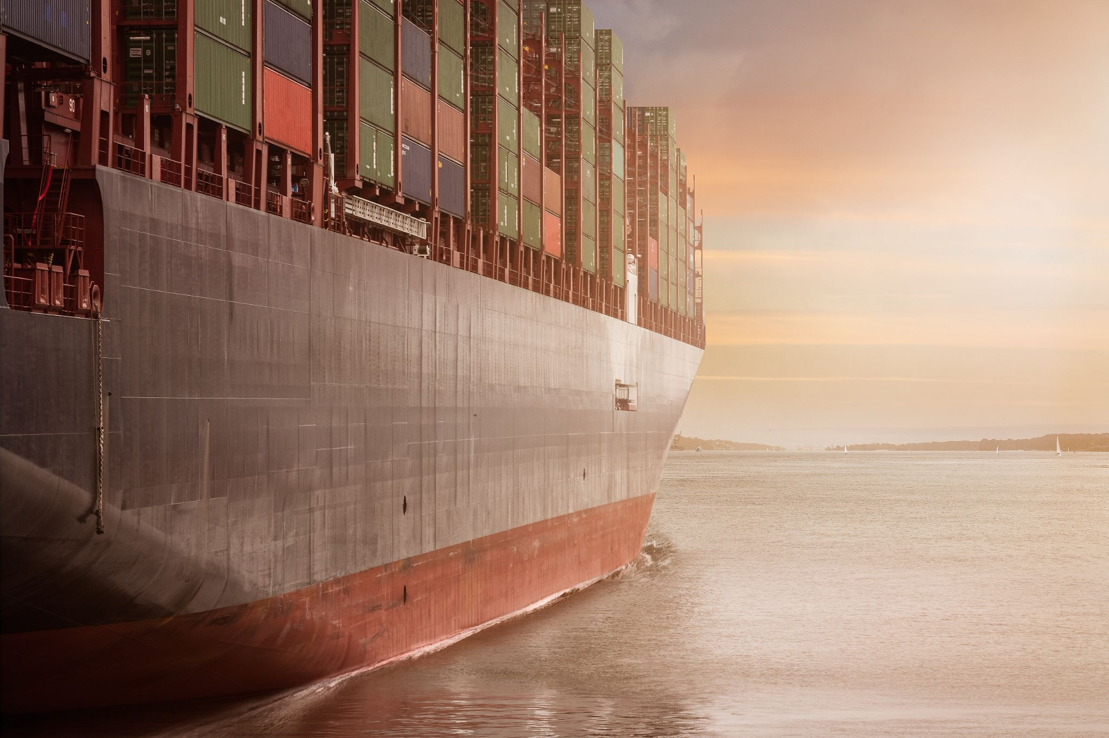

Slide 3
What is containerization?
“Containers are a way of packaging an application so that it’s easy to get the application and run it in any kind of environment. So, a lot of the complexity of installing and configuring an application is taken away.
Containers let a developer abstract all of that and make a very simple package that’s easy to consume.”
- Tim H, software engineer somewhere.

Slide 4
Let’s simplify it...
When you buy a car, what do you get?
Of course A CAR.
But you don’t get all the machinery that makes the car. You don’t get all the dies forgings and ERP process that car companies uses to make the car. You get a complete package, (read container), that is ready to run on the road. Could be any type of road.
Similar should happen with software. Isn’t it?

Slide 5
Simplified...
Software should not need any specific OS, additional libraries, any associated software for it to run.
Users should not have to configure or install or do anything else to make the software (car) run.
The software should run out of the box irrespective of the users environment.
This is what Containerization achieves.

Slide 6
Containerization! Again!
“Containers are a way of packaging an application so that it’s easy to get the application and run it in any kind of environment. So, a lot of the complexity of installing and configuring an application is taken away.
Containers let a developer abstract all of that and make a very simple package that’s easy to consume.”
- Tim H, software engineer somewhere.

Slide 7
Containers - What do they achieve?
Process Isolation - Each process runs in its own container, hence isolated
Consistent Environment - No change in environment
Run Anywhere - Write once run anywhere
Low Overhead - Containers are lightweight
Small Size - Containers are minimal linux kernels, small in size.

Slide 8
History
Containers first experimented with in the late 1990s, on the Linux platform.
By year 2006 the cpusets mechanism in the main Linux kernel moved it forward
After multiple improvements, namespaces being the most important one in 2008 containers started become important by 2008.
The Linux Container project (LXC) was created by IBM engineers in 2008.
Finally, LXC 1.0 was released in 2014, the year when Docker was also released.

Slide 9
VMs or Virtual Machines
A virtual machine (VM) is a virtual environment that functions as a virtual computer system with its own CPU, memory, network interface, and storage, created on a physical hardware system (located off- or on-premises). Software called a hypervisor separates the machine’s resources from the hardware and provisions them appropriately so they can be used by the VM.
Tools like Oracle Virtual Box and VMWare are used to create VMs.

Slide 10
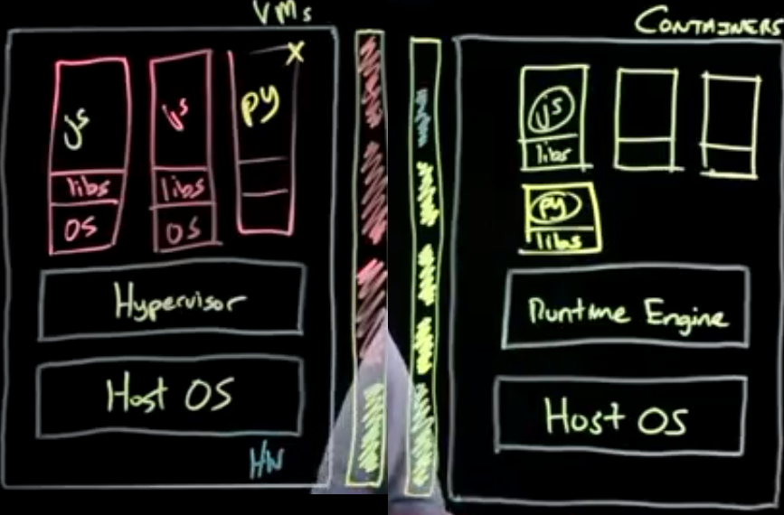
VMs vs Containers

Slide 11
Devops
Cultural movement
Inspired by agile methods
People, Processes & Tools
Continuous delivery
Infrastructure as code
Cross silo collaboration
Small iterations
Feedback loop, measurement

Slide 12
Containers are here to stay.
Containers have revolutionized the way software is developed.
Imperative to learn how Containers work.

